Slide 1



Improving Health Through Education & Analysis
An Evaluation of One Good Turn’s Kenya School Health Education Program
Please note that this version has been heavily edited to maintain data confidentiality.
Yolanda Sukloff, Spring 2024
Notes:
Good afternoon. My name is Yolanda Sukloff and this is a review of my practicum for Spring semester 2024 entitled Improving Health through Education & Analysis. An evaluation of One Good Turn’s Kenya School Health Education program.

Slide 2

BACKGROUND
DATA ANALYSIS PLAN
CHALLENGES
PROGRAM EVALUATION
ACCOMPLISHMENTS
CONCLUSION
Notes:
I’ll be discussing various aspects of my practicum including background, challenges, accomplishments, and the data analysis process that was utilized.

Slide 3
ONE GOOD TURN
Mission: Provide practical medical education and culturally sensitive medical care to underserved communities worldwide.
Program Of Interest: Kenya School Health Program
Project Responsibilities:
Assist in the development of KPIs
Conduct data analysis
Compile written reports
Conduct data analysis to evaluate the efficacy of training sessions.
One Good Turn (2021)
Notes:
- I was hosted by One Good Turn, a non-profit global health organization founded by my preceptor - Dr. Ann Messer.
- One Good Turn’s mission is to provide practical medical education and culturally sensitive medical care to underserved communities worldwide.
My project focus was their Kenya School Health Program, which aims to promote good health, safe and effective medical care, and practical education for school health officers, teachers, and students.
My project goals were to :
Assist in developing Key Performance Indicators to ascertain the program’s success.
Conduct data analysis to evaluate the efficacy of the program.
Compile written reports showcasing data analysis results.

Slide 4
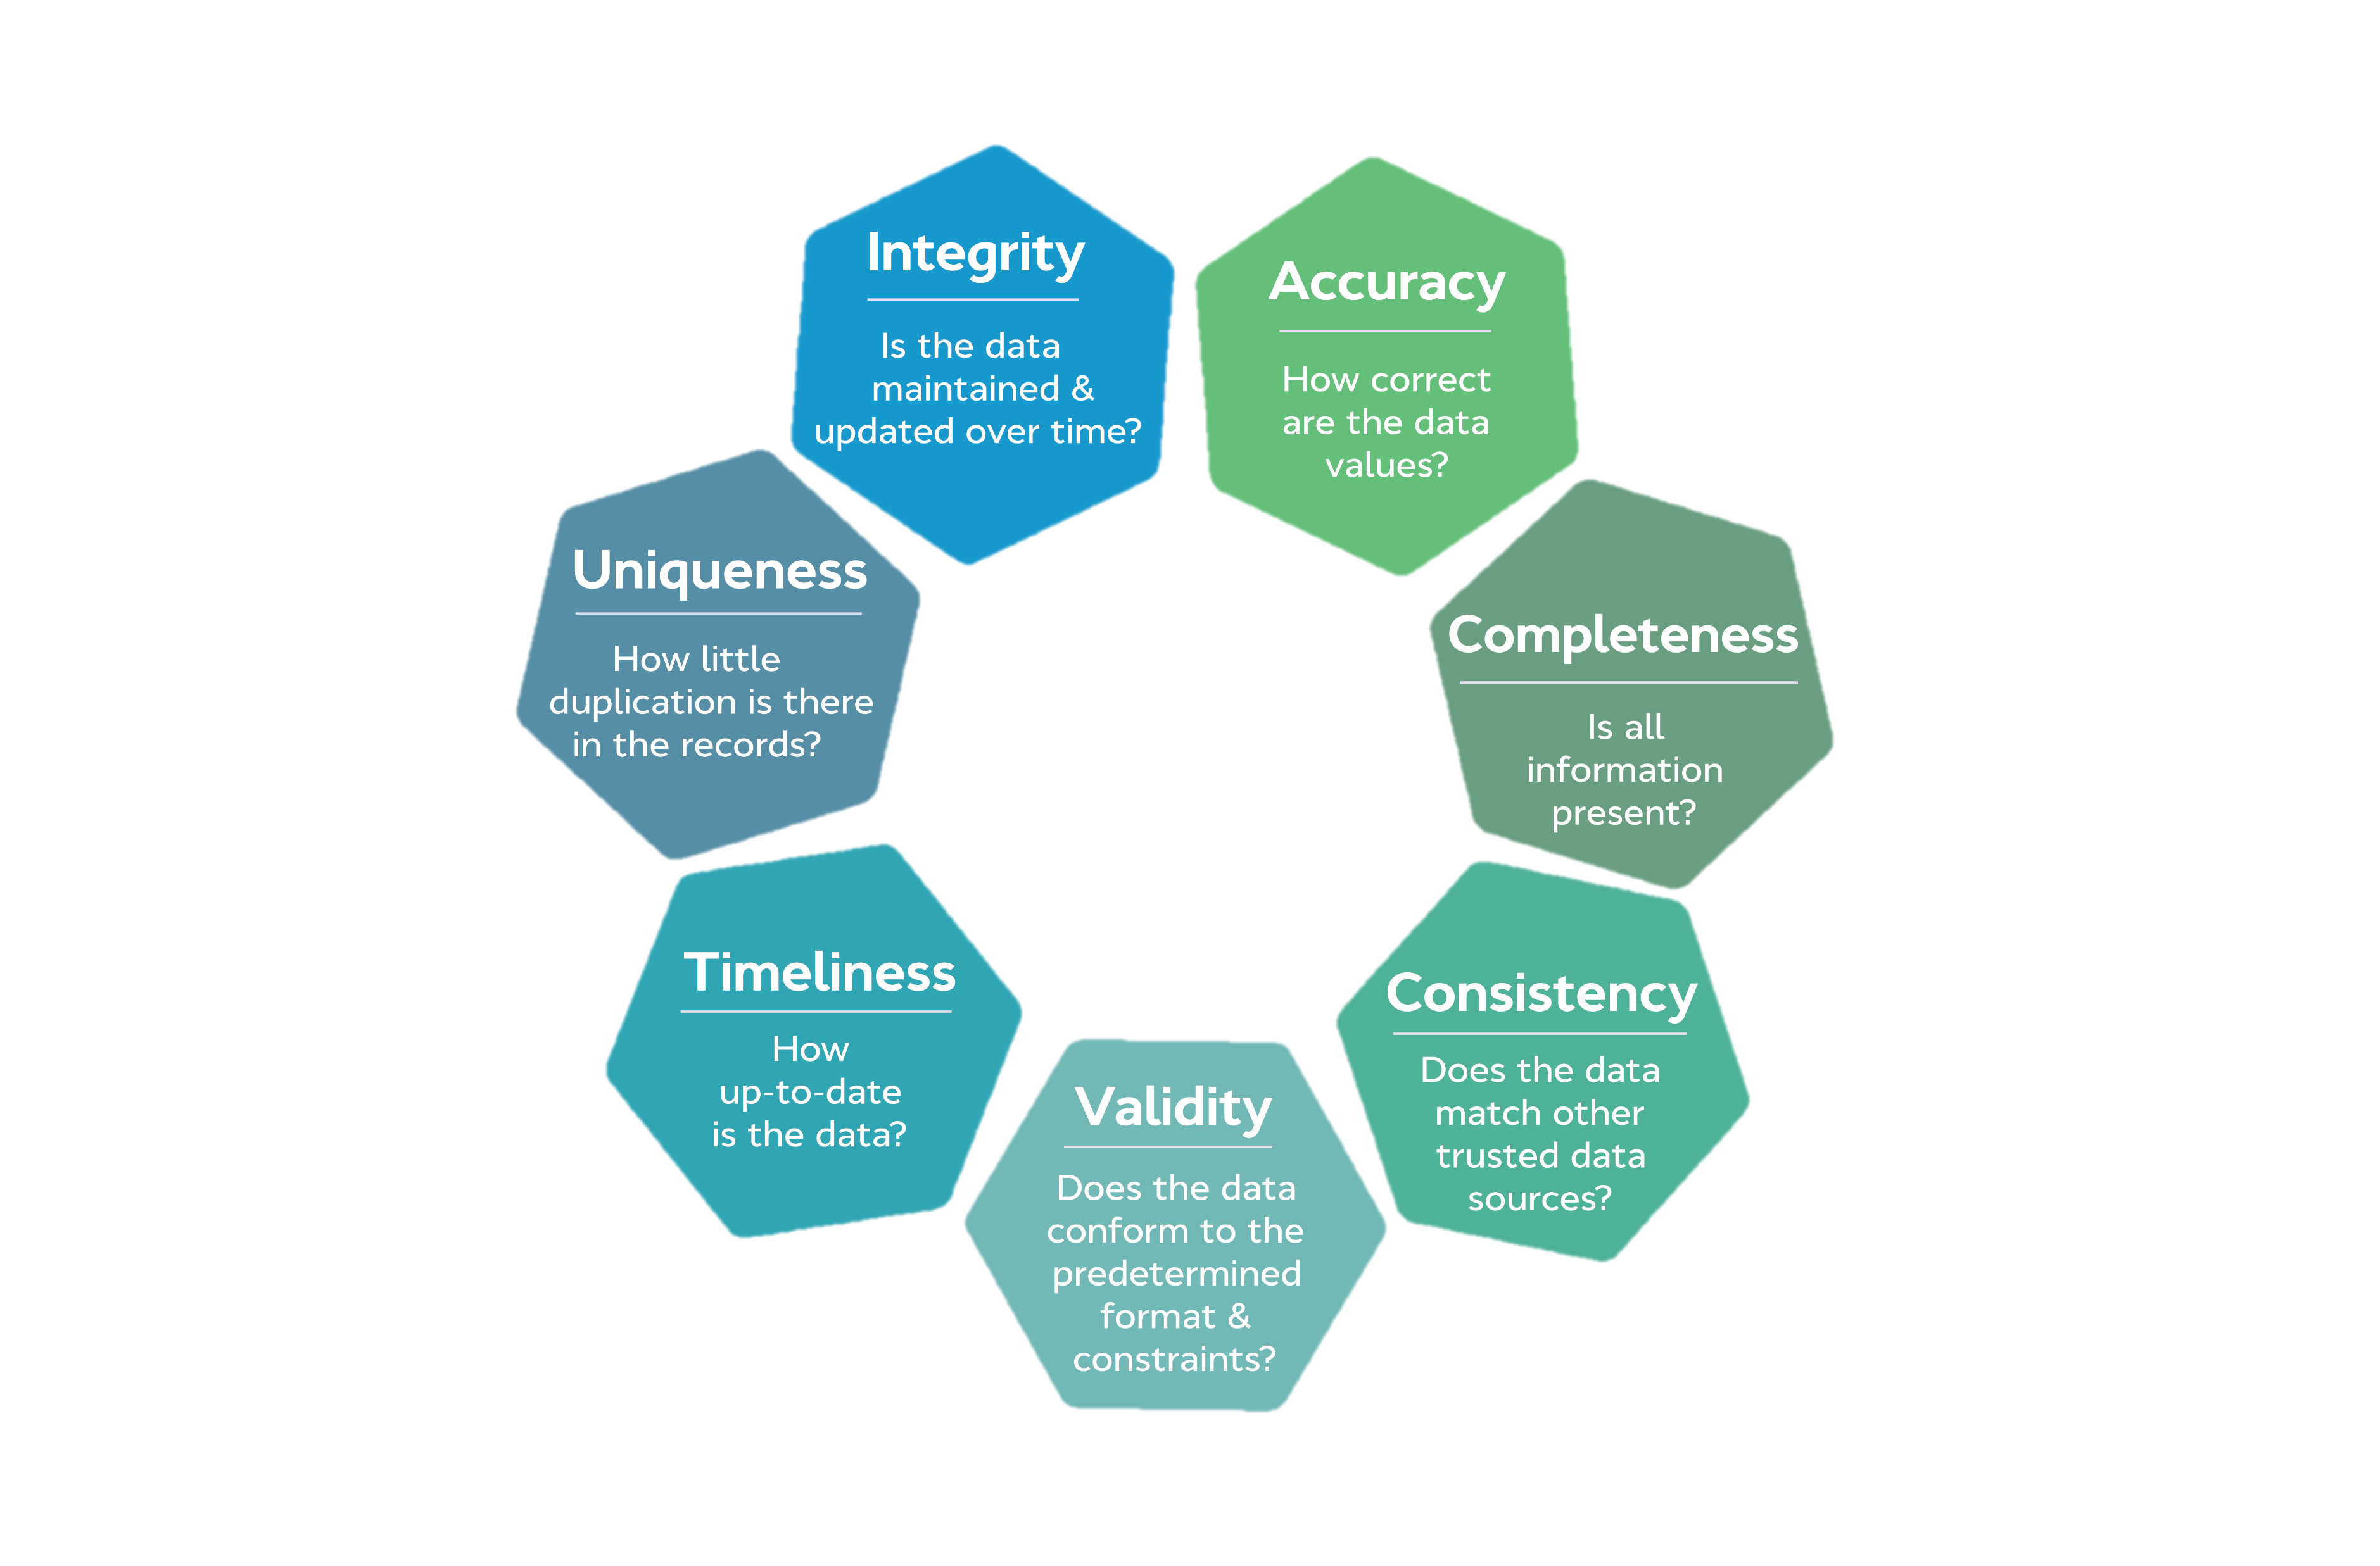
Data Collection Best Practices
Avoid biased questions
Avoid double-barreled questions
Avoid response fatigue
Choose appropriate question type
Consider data collection frequency
Consider ease of data analysis
Culturally appropriate
Promote data quality
Promote ethical data collection
Questions address KPIs
Use simple language
Data Quality
Dimensions
AHIMA. (2022).
Notes:
Data collection instruments were critiqued according to best practices that promote culturally appropriate, ethical data collection methods.
The questionnaires needed to utilize simple, direct language that free of bias and avoided response fatigue.
Data quality was critiqued according to the American Health Information Management Association’s recommendations which includes ensuring data is accurate, accessible, comprehensive, and of appropriate granularity and precision.
AHIMA characteristics of data quality are as follows:
1. Accuracy: The data should be free of errors, is correct.
2. Accessibility: Proper safeguards established to ensure data is available when needed.
3. Comprehensiveness: The data contains all required elements
4. Consistency: The data is reliable and the same across the entire patient encounter.
5. Currency: Data is current and up to date
6. Definition: All data elements are clearly defined.
7. Granularity: The data is at the appropriate level of detail.
8. Precision: The data is precise and collected in their exact form.
9. Relevancy: Data is relevant to the purpose it was collected
10. Timeliness: Documentation is entered promptly, is up-to-date and available within
specified and required time frames (AHIMA 2020)
https://www.ahima.org/media/pmcb0fr5/healthcare-data-governance-practice-brief-final.pdf
https://www.ovaledge.com/blog/data-quality-metrics

Slide 5

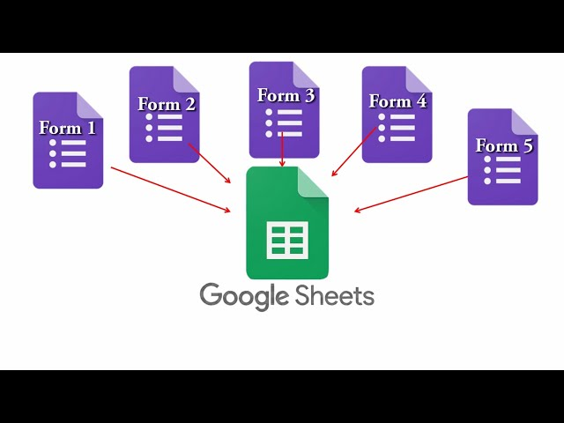
Ease of Use. Flexible. Free. Sustainable.
Data visualization was removed for data confidentiality.
Notes:
To streamline data management, I opted for Google Forms, a user-friendly survey administration tool.
It's not only free but also sustainable and scalable, making it an ideal choice for current and future program needs.
Our data collection instruments were transformed into Google Forms and various One Good Turn staff aided in transcribing the data.
As the form was integrated with a Google Sheet, this allowed another staff member to conduct a quality review of the data.
Although a crude estimate, the data visualizations provided by Google Forms were extremely helpful and were referenced in team meetings, while we awaiting final results.

